Slide 1
DISAPPEARING GENETIC RESOURCES
GROUP 19

Slide 2
GROUP MEMBERS
OSEI, JOSEPHINE
AMPONSAH, PETER
WARDEN, NANCY ABA
ADJEI, DANIEL
ACHEAMPONG, ASIAMAH GEORGE
AGBESI, URIELLE FIORINA F
KWARTENG, ANDREWS MAURICE
FRIMPONG, EMMANUEL SAKYI
AWUAH, ENOCK YAW
BAIDOO, SAMUEL

Slide 3
GENETIC RESOURCES
The United Nations Convention on Biological Diversity define genetic resources as “genetic material of actual or potential value” (CBD, 1992).
These resources contain the genetic diversity in different species and populations and play an important role in maintaining biodiversity.
They are used for scientific researches, pharmaceutical developments, crop improvement and breeding programs (CBD, 1992).

Slide 4
Disappearing GENETIC RESOURCES
Disappearing genetic resources refer to the genetic diversity that is at risk of being lost or becoming extinct due to unfavourable factors and human activities (FAO, 1996).
They include the genetic materials of species, populations, or individuals that are either endangered, threatened, or vulnerable to extinction (IPBES, 2019).

Slide 5
Factors causing genetic resource disappearance
Habitat destruction
Invasive species
Pollution
Population size
Overexploitation of resources
Climate conditions

Slide 6
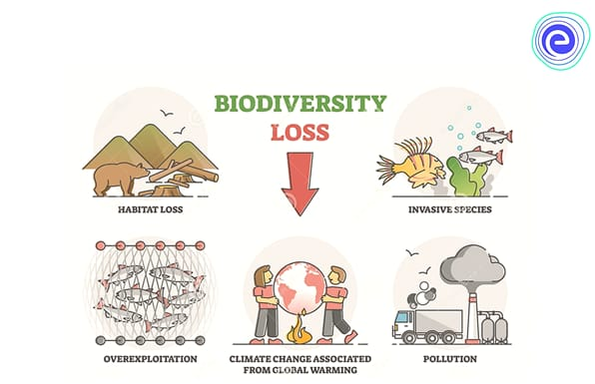

FIG 1.0 Factors causing genetic resource disappearance

Slide 7
Effects of genetic disappearing resources
Decreased food security or Food scarcity.
Biodersity loss.
Reduced resilience and Adaptation in species and ecosystems.
Impaired Ecosystem functioning and stability.
Lost of Medicinal and Industrial potential.
Economic challenges

Slide 8
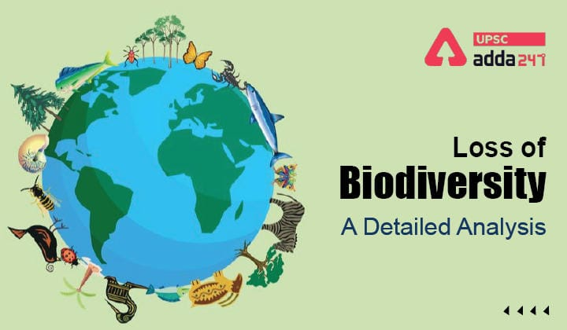
FIG 2.0 Effect of disappearing genetic resoueces

Slide 9
WAYS TO CONSERVE GENETIC RESOURCES
Establishment of protected areas.
Seed and Gene banks.
Implementation of sustainable management practices.
Conservation of natural habitats.
Enhancing Public Awareness and Education

Slide 10
REASONS TO CONSERVE GENETIC RESOURCES
Helps to maintain biodiversity
Promote food security
Promote medicinal and industrial research
Improved quality of life

Slide 11
CONCLUSION
The integrity of the environment and human welfare become significantly threatened with the depletion of genetic resources. It is our responsibility to conserve genetic resources to have a quality life

Slide 12
REFERENCES
United Nations Convention on Biological Diversity (CBD) (1992). Convention on Biological Diversity. Retrieved from https://www.cbd.int/convention/
FAO. (1996). Global Plan of Action for the Conservation and Sustainable Utilization of Plant Genetic Resources for Food and Agriculture. Retrieved from https://www.fao.org/3/x7849e/x7849e00.htm
IPBES. (2019). Summary for policymakers of the global assessment report on biodiversity and ecosystem services. Retrieved from https://ipbes.net/sites/default/files/2020-02/ipbes_global_assessment_report_summary_for_policymakers_en.pdf
Wadie Naomi Ampomaa (2008). The disappearing genetic resources. Kwame Nkrumah University of Science and Technology. https://ir.knust.edu.gh/handle/123456789/987

